Slide 1
Blood Visual Abstracts
2-Point Visual Abstract Templates
Notes:
Slide # 1. Title

Slide 2
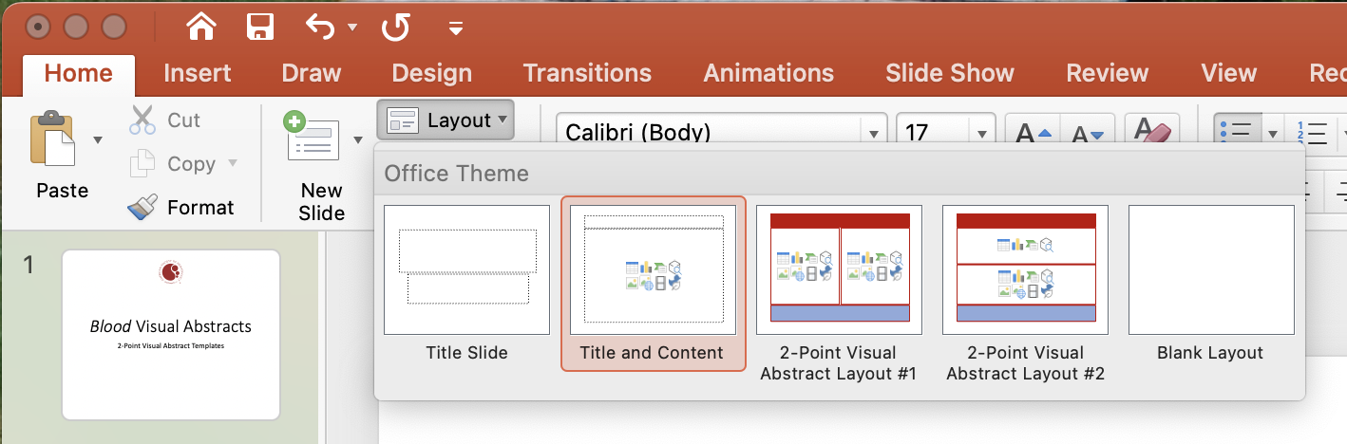
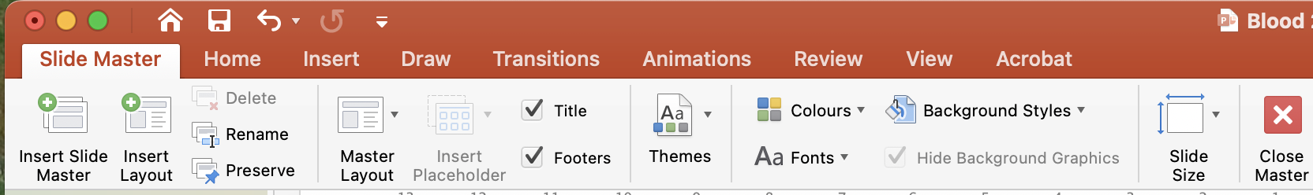
User Guide
This PowerPoint file has been conceived to help Blood Authors prepare their visual abstracts.
Slide #3 reports Template #1 for creating a 2-point visual abstract (Layout->drop-down menu->2-Point Visual Abstract Layout #1):
Slide #4 reports Template #2 for creating a 2-point visual abstract (Layout->drop-down menu->2-Point Visual Abstract Layout #2).
The 2 points (vertical or horizontal rectangles) should summarize the Context of research and the Main outcomes/findings. The 2 points are preceded by the Research title (short and simple, not necessarily the article title) and followed by the Conclusions (1 or 2 Key Points) with DOI
Please use text sparingly and include clear images: Focus on the main points exclusively.
You may modify the templates, but please do not distort them substantially. To modify a PowerPoint template, you should click View and select Master Views->Slide Master. Duplicate an existing template, modify it, and save changes. Then, Rename the duplicated template (with a new name) and return to the normal view:
Your Visual Abstract will be peer-reviewed and you might be invited to modify/improve it before publication online.
Final edits/adjustments will be made inhouse during production.
Notes:
Slide #2. User Guide

Slide 3
Notes:
Slide #3. 2-Point Visual Abstract Template #1

Slide 4
Notes:
Slide #4. 2-Point Visual Abstract Template #2

Slide 5
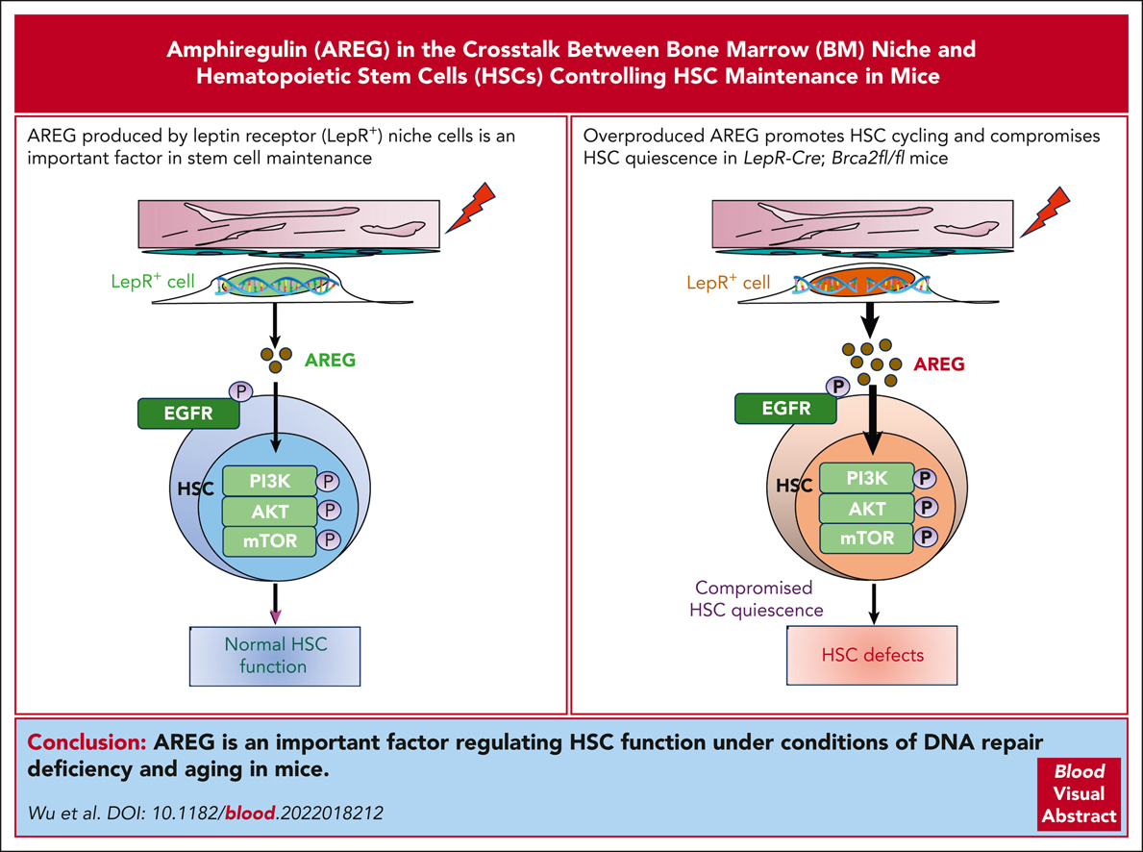

LepR⁺ niche cell–derived AREG compromises hematopoietic stem cell maintenance under conditions of DNA repair deficiency and aging
Limei Wu,Qiqi Lin,Srinivas Chatla,Surya Amarachintha,Andrew F. Wilson,Neha Atale,Zhenxia J. Gao,Jonathan Joseph,Emily V. Wolff,Wei Du, LepR⁺ niche cell–derived AREG compromises hematopoietic stem cell maintenance under conditions of DNA repair deficiency and aging, Blood, 2023,
Copyright © 2023 American Society of Hematology
Notes:
Blood Research Article

Slide 6
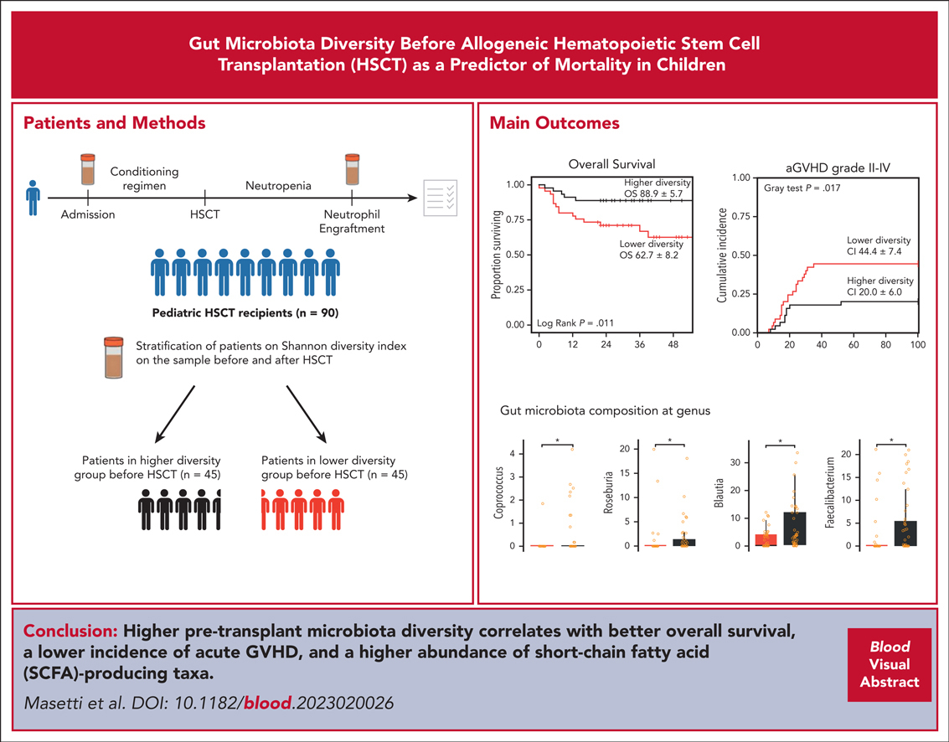
Gut microbiota diversity before allogeneic hematopoietic stem cell transplantation as a predictor of mortality in children
Riccardo Masetti,Davide Leardini,Edoardo Muratore,Marco Fabbrini,Federica D’Amico,Daniele Zama,Francesco Baccelli,Francesca Gottardi,Tamara Belotti,Marek Ussowicz,Jowita Fraczkiewicz,Simone Cesaro,Marco Zecca,Pietro Merli,Marco Candela,Andrea Pession,Franco Locatelli,Arcangelo Prete,Patrizia Brigidi,Silvia Turroni, Gut microbiota diversity before allogeneic hematopoietic stem cell transplantation as a predictor of mortality in children, Blood, 2023,
Copyright © 2023 American Society of Hematology
Notes:
Blood Research Article

Slide 7
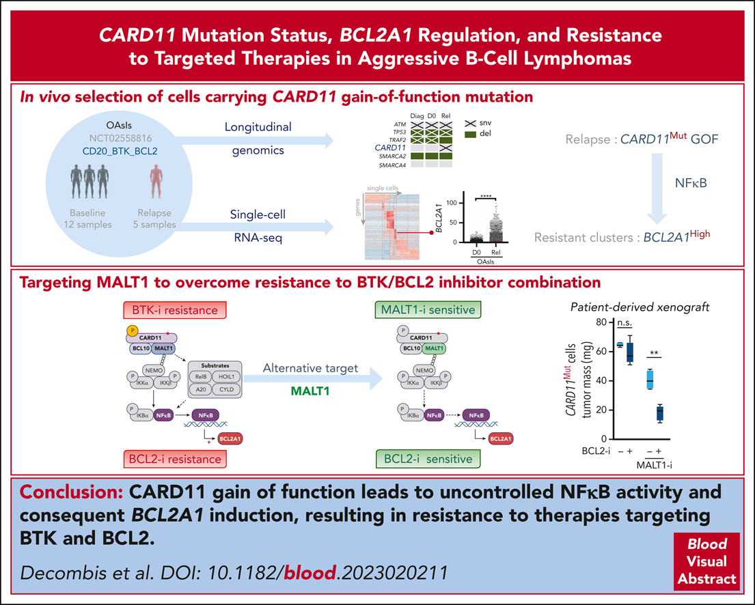
CARD11 gain of function upregulates BCL2A1 expression and promotes resistance to targeted therapies combination in B-cell lymphoma
Salomé Decombis,Celine Bellanger,Yannick Le Bris,Candice Madiot,Jane Jardine,Juliana Carvalho Santos,Delphine Boulet,Christelle Dousset,Audrey Menard,Charlotte Kervoelen,Elise Douillard,Philippe Moreau,Stephane Minvielle,Agnes Moreau-Aubry,Benoit Tessoulin,Gael Roue,Nicolas Bidère,Steven Le Gouill,Catherine Pellat-Deceunynck,David Chiron, CARD11 gain of function upregulates BCL2A1 expression and promotes resistance to targeted therapies combination in B-cell lymphoma, Blood, 2023,
Copyright © 2023 American Society of Hematology
Notes:
Blood Research Article

Slide 8
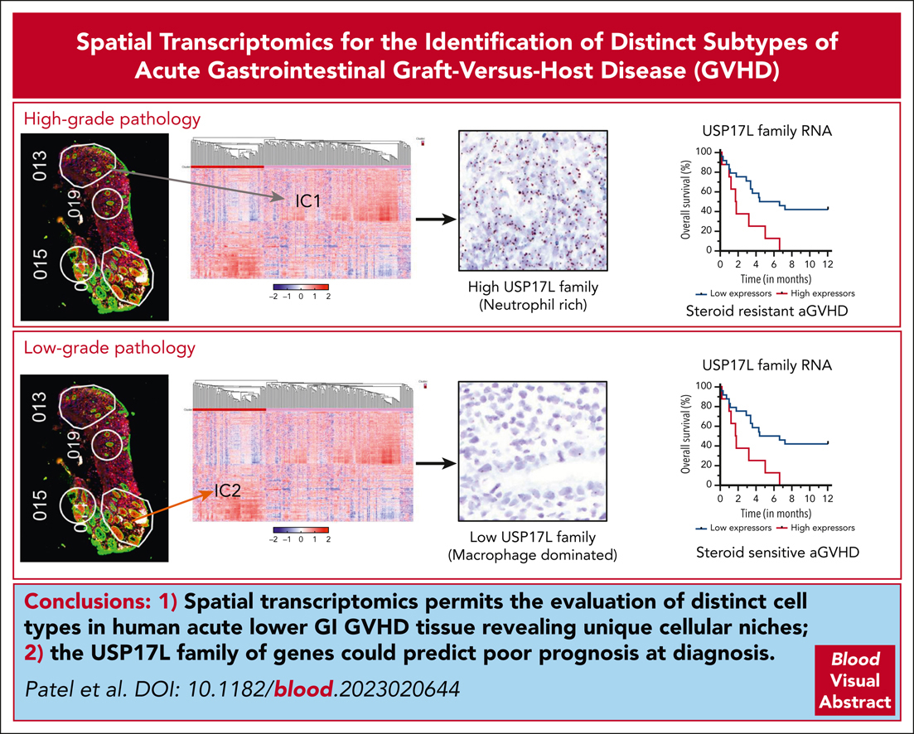
Spatial transcriptomics reveals distinct tissue niches linked with steroid responsiveness in acute gastrointestinal GVHD
Bidish K. Patel,Michael J. Raabe,Evan R. Lang,Yuhui Song,Chenyue Lu,Vikram Deshpande,Linda T. Nieman,Martin J. Aryee,Yi-Bin Chen,David T. Ting,Zachariah DeFilipp, Spatial transcriptomics reveals distinct tissue niches linked with steroid responsiveness in acute gastrointestinal GVHD, Blood, 2023,
Copyright © 2023 American Society of Hematology
Notes:
Blood Research Article

